Slide 1
FLIGHT PLAN 2028
WBS AND GANTT CHART

Slide 2
BALANCED SCORECARD ESSENTIALS
What is a Project Plan?

Slide 3
BALANCED SCORECARD ESSENTIALS
PROJECT PLAN
It is an attempt at the timetable for ALL the activities which make up the project.
As a minimum, it sets out: -how -who does -what -when
A more sophisticated plan also states: -what quality -what cost and resources

Slide 4
BALANCED SCORECARD ESSENTIALS
WHO IS RESPONSIBLE FOR PROJECT PLAN?
The Project Manager and the Project Management Team (Strategic Initiatives Champions and Unit SMOs)
With the advice and assistance of:
the Strategic Initiative Adviser
the Stakeholders

Slide 5
BALANCED SCORECARD ESSENTIALS
WHAT ARE THE ELEMENTS OF PROJECT PLAN?
Project goals or Project Statement of Work:
Project product specifications, costs, quality, deadlines, project deliverables, and others
Project management plan
Work breakdown structure or WBS
Project network or connections of tasks

Slide 6
BALANCED SCORECARD ESSENTIALS
WHAT ARE THE ELEMENTS OF PROJECT PLAN?
5. Project goals or Project Statement of Work
6. Project product specifications, costs, quality, deadlines, project deliverables, and others
7. Project management plan
8. Work breakdown structure or WBS
9. Project network or connections of tasks

Slide 7
BALANCED SCORECARD ESSENTIALS
WHAT ARE THE ELEMENTS OF PROJECT PLAN?
ITERATIVE PROCESS
Project goals or Project Statement of Work
Project management plan
Work breakdown structure or WBS
Project network or connections of tasks
Project goals or Project Statement of Work
Project product specifications, costs, quality, deadlines, project deliverables, and others
Project management plan
Work breakdown structure or WBS
Project network or connections of tasks

Slide 8
BALANCED SCORECARD ESSENTIALS
WHAT ARE THE ELEMENTS OF PROJECT PLAN?
ITERATIVE PROCESS
Project goals or Project Statement of Work
Project management plan
Work breakdown structure or WBS
Project network or connections of tasks
Project goals or Project Statement of Work
Project product specifications, costs, quality, deadlines, project deliverables, and others
Project management plan
Work breakdown structure or WBS
Project network or connections of tasks

Slide 9
BALANCED SCORECARD ESSENTIALS
WORK
BREAKDOWN STRUCTURE

Slide 10
BALANCED SCORECARD ESSENTIALS
What is Work Breakdown Structure?

Slide 11
BALANCED SCORECARD ESSENTIALS
WORK BREAKDOWN STRUCTURE
A tool used to define and group a project's discrete work elements (tasks) in a way that helps organize and define the total work scope of the project.
It is designed to help break down a project into manageable chunks that can be effectively estimated and supervised
The project is divided into hierarchical groups of tasks (work packages, and work units).

Slide 12
BALANCED SCORECARD ESSENTIALS
WIDELY USED REASONS FOR CREATING WBS
Assists with accurate project organization
Helps with assigning responsibilities
Shows the control points and project milestones
Allows for more accurate estimation of cost, risk and time
Helps explain the project scope to stakeholders

Slide 13
BALANCED SCORECARD ESSENTIALS
Not every breakdown of project deliverables can be classified as a WBS. For it to be called a work breakdown structure, it must have certain characteristics:

Slide 14
BALANCED SCORECARD ESSENTIALS
CHARACTERISTICS OF WBS
Hierarchy: The WBS is hierarchical in nature. Each “child” level exists in a strict hierarchical relationship with the parent level. The sum of all the child elements should give you the parent element.
100% rule: Every level of decomposition must make up 100% of the parent level. It should also have at least two child elements.

Slide 15
BALANCED SCORECARD ESSENTIALS
CHARACTERISTICS OF WBS
Mutually exclusive: All elements at a particular level in a WBS must be mutually exclusive. There must be no overlap in either their deliverables or their work. This is meant to reduce miscommunication and duplicate work.
Outcome-focused: The WBS must focus on the result of work, i.e. deliverables, rather than the activities necessary to get there. Every element should be described via nouns, not verbs. This is a big source of confusion for beginners to WBS.

Slide 16
BALANCED SCORECARD ESSENTIALS
When creating WBS follow this simple rule:
WBS = nouns
Scheduled Activities = Verbs

Slide 17
BALANCED SCORECARD ESSENTIALS
POSSIBLE LEVELS IN WBS
Project
Sub-projects
Deliverables
Sub-deliverables
Work packages
Work units

Slide 18
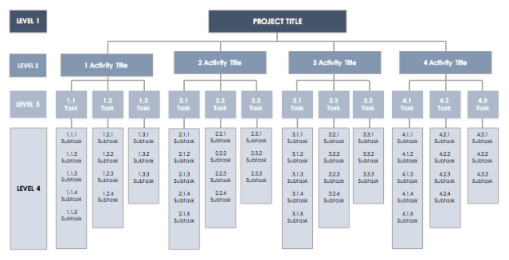
BALANCED SCORECARD ESSENTIALS
EXAMPLE OF WBS

Slide 19
BALANCED SCORECARD ESSENTIALS
EXAMPLE OF WBS
holiday
travel
documents
booking
household
passport
tickets
resort
confirmation
pets
insurance
brochures

Slide 20
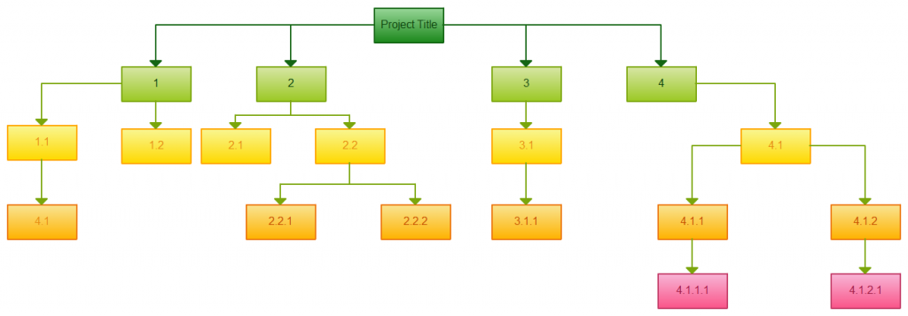
BALANCED SCORECARD ESSENTIALS
EXAMPLE OF WBS

Slide 21
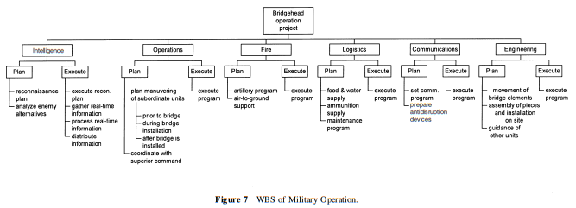
BALANCED SCORECARD ESSENTIALS
EXAMPLE OF WBS

Slide 22
BALANCED SCORECARD ESSENTIALS
Create a WBS for the Arusha public transport case

Slide 23
BALANCED SCORECARD ESSENTIALS
Table 2 : Design Summary of the Public Transport Project
Design Summary
Impact The transport system of Arusha is functioning well.
Outcome APT provides safe and reliable public transport services.
Outputs Bus fleet is well maintained. Drivers observe safety and traffic regulations.
Activities Establish and follow the bus maintenance schedule Establish and operate an inventory control system Obtain preferential import license for spare parts Procure spare parts Upgrade mechanical workshop Upgrade skills of bus mechanics | Inputs ADB - $ 15 million Consulting services 50 PMs - $ 1.25 million Civil works - $ 2 million Equipment - $ 8 million Training - $ 2.75 million Contingencies - $ 1 million Government - $ 5 million Personnel 150PMs - $ 2 million Transport and logistics - $1.5 million Operating expenses - $1.5 million
Introduce a national bus driver license and examination system Establish bus safety and operating regulations Train and test bus drivers. Introduce incentives for safe driving

Slide 24
BALANCED SCORECARD ESSENTIALS
SAMPLE ANSWERS
PROFESSIONAL DRIVERS
TRAINING
LICENSE
SKILL UPGRADING OF DRIVERS
NATIONAL BUS DRIVER LICENSE SYSTEM
DRIVERS’ EXAMINATION SYSTEM

Slide 25
BALANCED SCORECARD ESSENTIALS
SAMPLE ANSWERS
WELL-FUNCTIONING BUS FLEET
MAINTENANCE
PROCUREMENT
SPARE PARTS
MAINTENANCE SCHEDULE
MECHANICAL WORKSHOP
IMPORT LICENSES
INVENTORY CONTROL SYSTEM

Slide 26
BALANCED SCORECARD ESSENTIALS
GANTT CHART

Slide 27
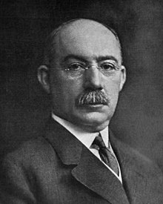
BALANCED SCORECARD ESSENTIALS
GANTT CHART
Henry Gantt (1861 - 1919) an American mathematical engineer.

Slide 28
BALANCED SCORECARD ESSENTIALS
WHAT IS A GANTT CHART?
A timeline view of your project.
A tool that helps you manage all of the different resources, people, and tasks along the way to accomplishing the goal of your project.
A type of bar chart that illustrates a project schedule.
Illustrates the start and finish dates of the work elements (tasks) of a project.

Slide 29
BALANCED SCORECARD ESSENTIALS
ELEMENTS OF A GANTT CHART
Task names.
Start and finish dates of each tasks, represented graphically.
Task duration in an additional column.
Lag relationships, like start-to-start, finish-to-start and others.
Name of the project worker responsible for the task or resource specification.

Slide 30
BALANCED SCORECARD ESSENTIALS
SAMPLE GANTT CHART
ID | Activities | Who is responsible? | Time intervals 1. 2. 3. 4. 5. 6. 7. 8.
1.
2.
3.
4.
5.
6.
7.
8
9
10.
11.

Slide 31
BALANCED SCORECARD ESSENTIALS
SAMPLE GANTT CHART

Slide 32
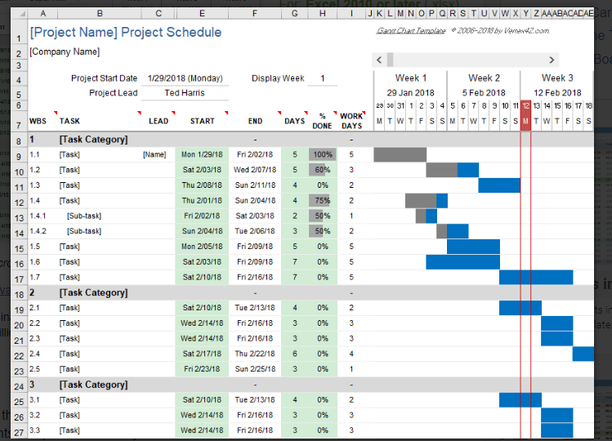
BALANCED SCORECARD ESSENTIALS
SAMPLE GANTT CHART

Slide 33
BALANCED SCORECARD ESSENTIALS
GANTT CHART
Some Gantt charts also show the dependency relationships between activities.
activities
time
1.
2.
3.
4.
5.
6.

Slide 34
BALANCED SCORECARD ESSENTIALS
BENEFITS OF A GANTT CHART
easy to understand
gives clarity of dates
enables time management
brings efficiency
ensures accountability in terms of timeline
expects coordination among stakeholders in order to deliver things as per Gantt timeline.

Slide 35
BALANCED SCORECARD ESSENTIALS
LIMITATIONS OF USING A GANTT CHART
Can become quite unwieldy for projects with too many activities.
Projects are often too complex for a Gantt chart.
Gantt charts represent only a part of the project constraints.
The technique of creating a Gantt chart depends on the features of the project.

Slide 36
THANK YOU AND GOOD DAY!

